Slide 2
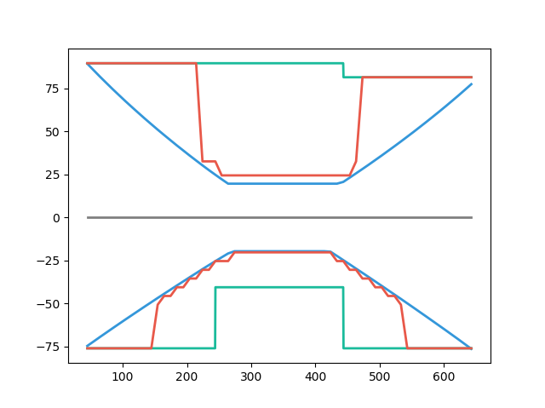
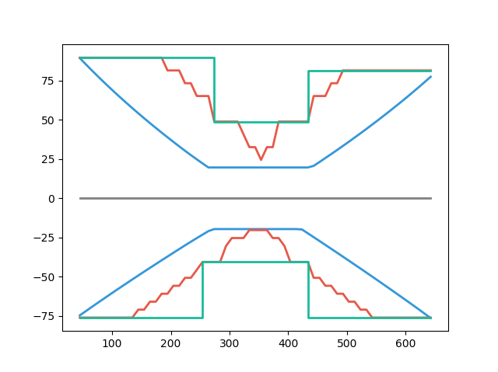
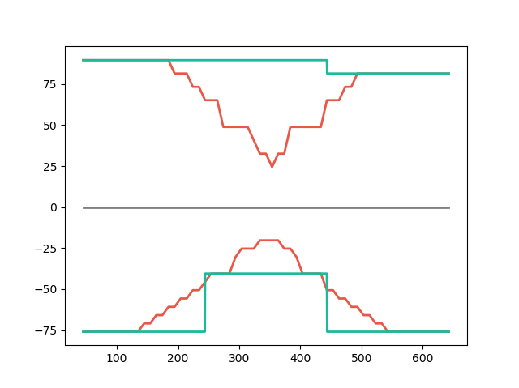
BEFORE
AFTER
CONSERVATION
SMART CUT
SIMPLE Ld
86%
80%
ETABS DEMAND
ETABS DEMAND
87%
EXPLICIT Ld
102%
102%
REAL SOL
NO CONSERVATIVE
CONSERVATION

Slide 3
BEFORE
AFTER
傳統設計 CONVENTION CUT
優化斷筋 SMART CUT
REBAR USED
SIMPLIFIED Ld
REBAR USED
100%
86%
EXPLICIT Ld
80%
ETABS DEMAND
ETABS DEMAND
ETABS DEMAND
100%
ETABS DEMAND
87%
102%
EXPLICIT Ld
SIMPLIFIED Ld
REBAR USED
REBAR USED
經驗斷筋位置1/3
經驗斷筋
位置1/3
102%
REAL SOL
現有設計流程可能不保守
CONSERVATION

Slide 4
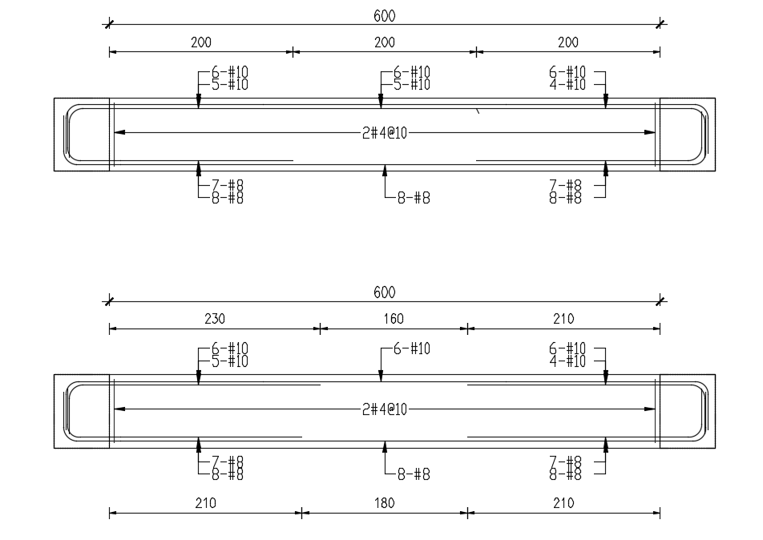
優化配筋圖
200
BEFORE
一般作法
11-#10
AFTER
更安全 更準確 更經濟
上層節省14%; 下層更安全
230
6-#10

